Slide 1
MyNHANES
Optimizing NHANES Data Utilization
Challenges and Opportunities
Andre Rico
IBI - App Dev

Slide 2

National Health and Nutrition Examination Survey (NHANES)
Objective + Methodology
NHANES is a program of studies designed to assess the health and nutritional status of adults and children in the United States.
Notes:
Objective The primary objective of NHANES is to collect data that can be used to determine the prevalence of major diseases and risk factors for diseases, and to monitor trends in health and nutrition over time.
Methodology NHANES combines interviews and physical examinations. The interviews include questions about demographics, socioeconomics, diet, and health. The physical examinations include medical, dental, and laboratory tests performed by trained health professionals.
Valuable Data
NHANES provides comprehensive data on health and nutrition.
Includes demographics, dietary information, health conditions, laboratory results, and more.
Essential for public health research, policy-making, and setting health standards.

Slide 3
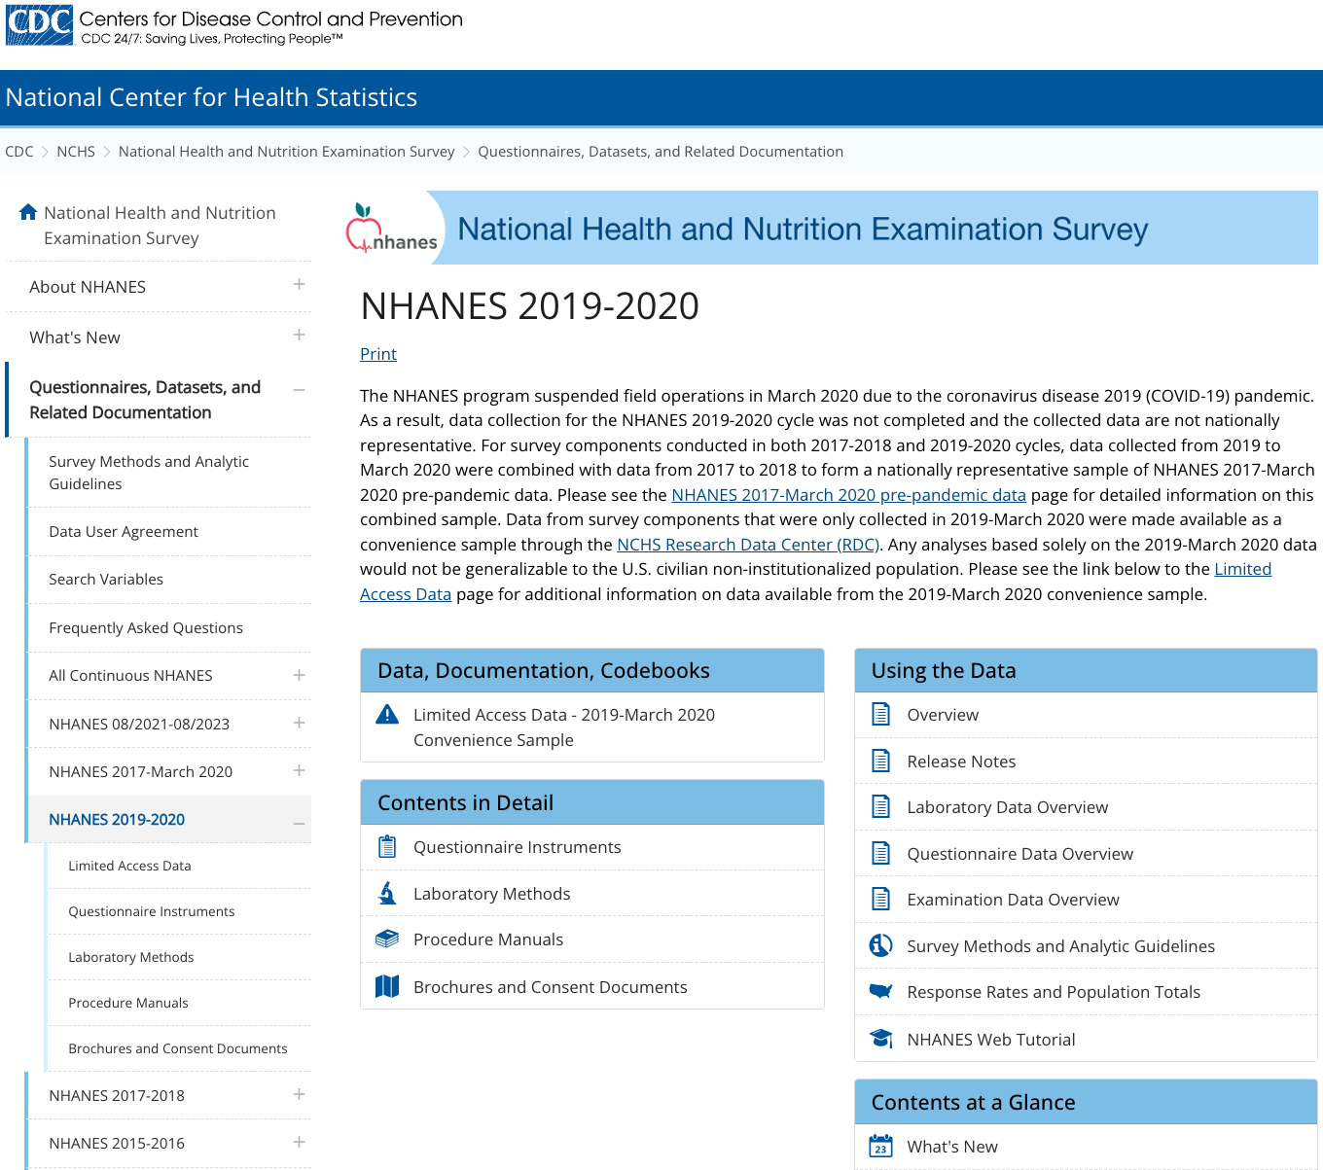

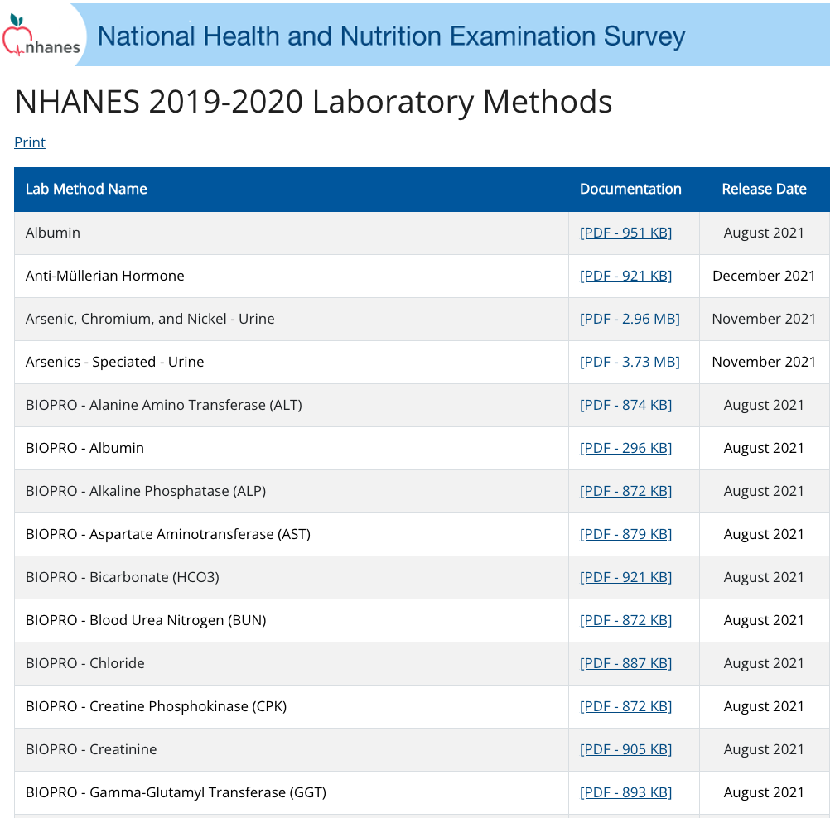

Slide 4
NHANES Data Challenges
Key Aspects of nhanes data management
Exploration Challenges
Fragmented data: Each cycle and category must be individually accessed and processed.
Requires specialized tools (like SAS) or conversion to more accessible formats (CSV, SQL, etc.).
Time-consuming and resource-intensive to integrate and analyze data across multiple cycles and categories.
Initiatives
Harmonized US National Health and Nutrition Examination Survey 1988-2018 for high throughput exposome-health discovery
https://www.ncbi.nlm.nih.gov/pmc/articles/PMC9934713/
Challenges and Lessons Learned in Generating and Interpreting NHANES Nutritional Biomarker Data
https://www.ncbi.nlm.nih.gov/pmc/articles/PMC5347107/

Slide 5
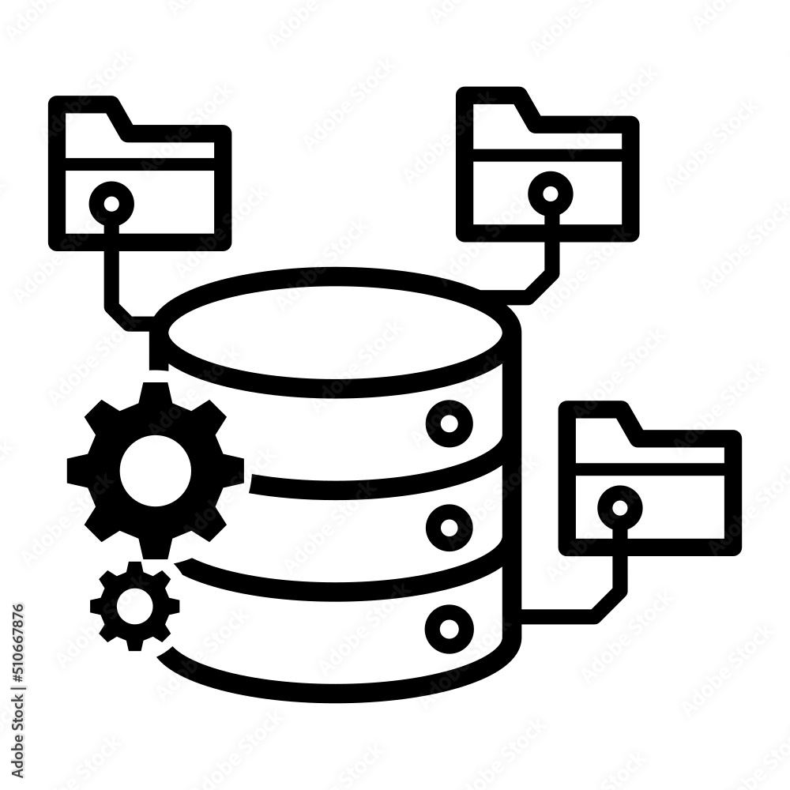
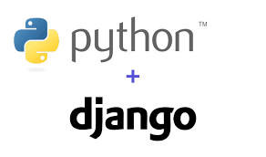
MyNHANES: Optimizing NHANES Data Utilization
An integrated platform for efficient NHANES data management
Key Features:
Integrates all NHANES variables (>12K) across all cycles.
Master Data Management: organize cycles, datasets, variables, and tags.
Work Process: manage the complete dataset lifecycle (download -> ingestion -> analysis).
Transformations: apply customizable normalization and cleaning rules.
Query Builder & Export: build dynamic queries and export results.
Web Interface + API: access via Django Admin and REST API.
Technology Stack:
Django + SQLite or PostgreSQL (simple, lightweight, portable)
Python 3.12+

Slide 6
MyNHANES: Common Normalization Rules Area
Standardizing NHANES data for consistent and reliable analysis
What is it?
A set of predefined rules applied to NHANES data to ensure consistency, comparability, and readiness for analysis.
Examples:
Raw Data | Normalization Rule Applied | Normalized Data
LDL (statin user) = 100 | LDL / 0.8 | 125
BMI measured in 2000 vs 2010 | Adjust procedural bias | Harmonized BMI
Benefits:
Ensures data comparability across cycles.
Reduces bias from methodological changes.
Saves time and improves analysis reproducibility.

Slide 7
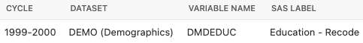
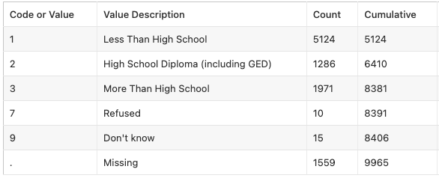

Examples of Common Normalization Rules Area
7
9
missing
Reclassify responses coded
and
LDL
STALIN
LDL-N
Apply a rationale (LDL / 0.8) to participants that use statin.
Diff HDL Approach over the years
HDL 1999
HDL 2006
HDL 2018
Apply a rationale rule to consolidate
HDL
HDL
Single HDL Field
HDL
Normalize measurements that have had procedural changes over the years.

Slide 8

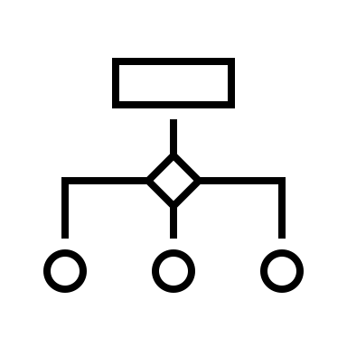


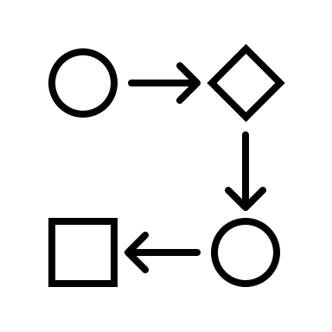
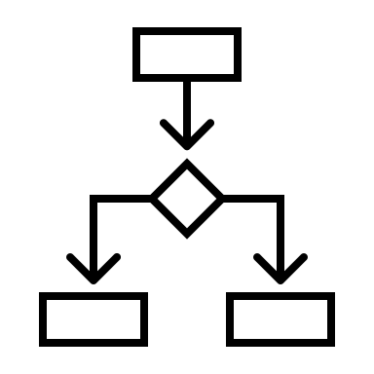

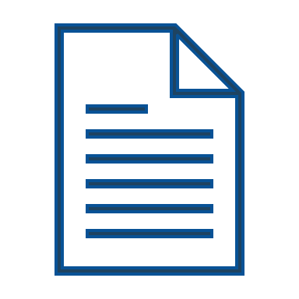







Common Normalization Rules Area
NHANES
Publications
Paper A
Paper B
Paper C
Work Process
Control, Load and Aggregation
Raw Data
Normalized Data
…….. 1,351 xpt files with data
Query
……1,351 pages w/information
MyNHANES
User Analysis

Slide 9
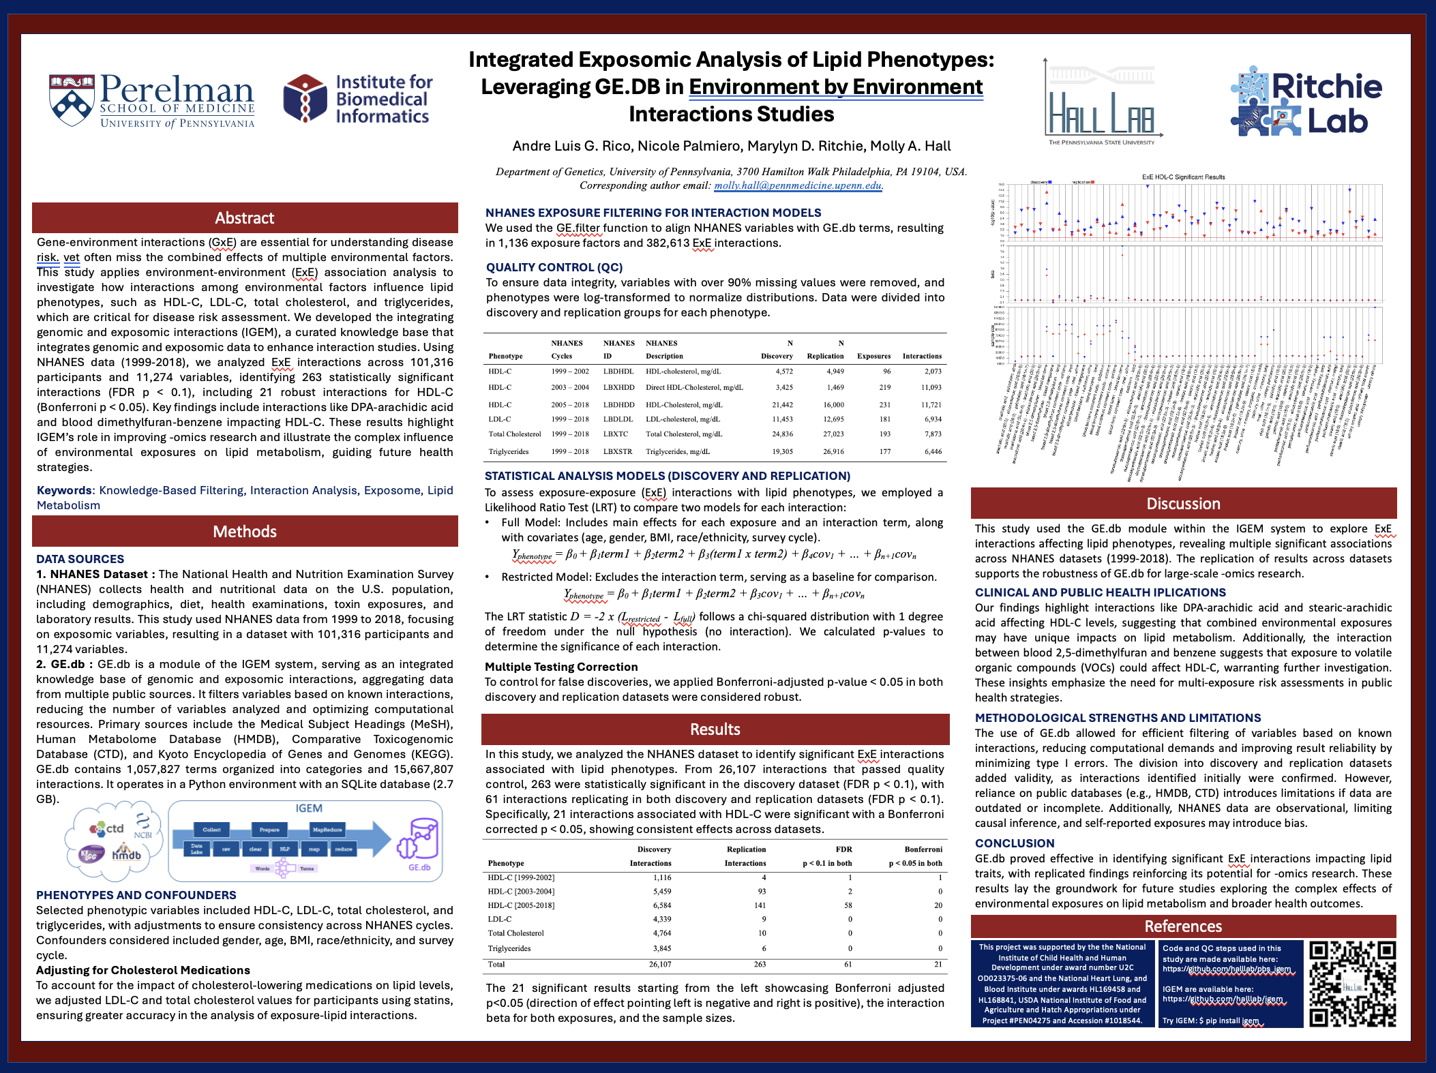
Efficient data selection for ExE interaction analysis powered by MyNHANES

Slide 10
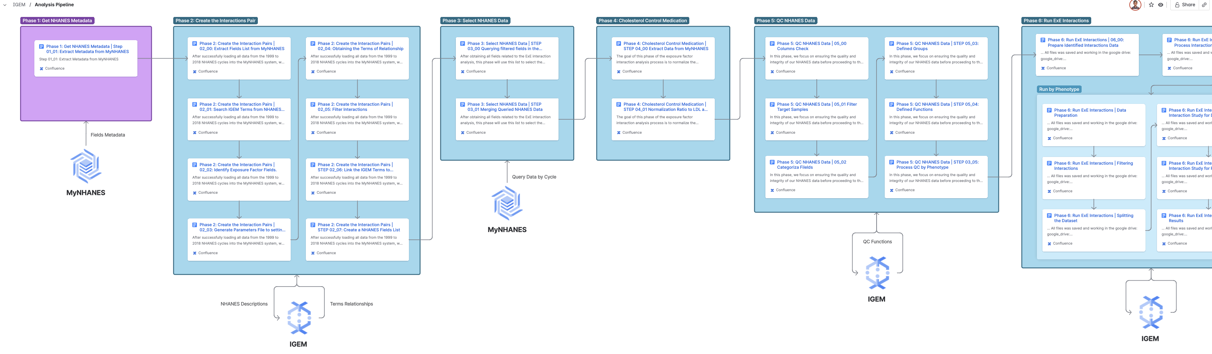
Data selection for ExE interaction analysis
Used MyNHANES to select variables and retrieve datA
The analysis began by using TAGs to filter over 12,000 variables, focusing on Environment and Exposure-related data
After using a knowledge base to filter variables by label for the analysis, we returned to MyNHANES to retrieve the corresponding data

Slide 11
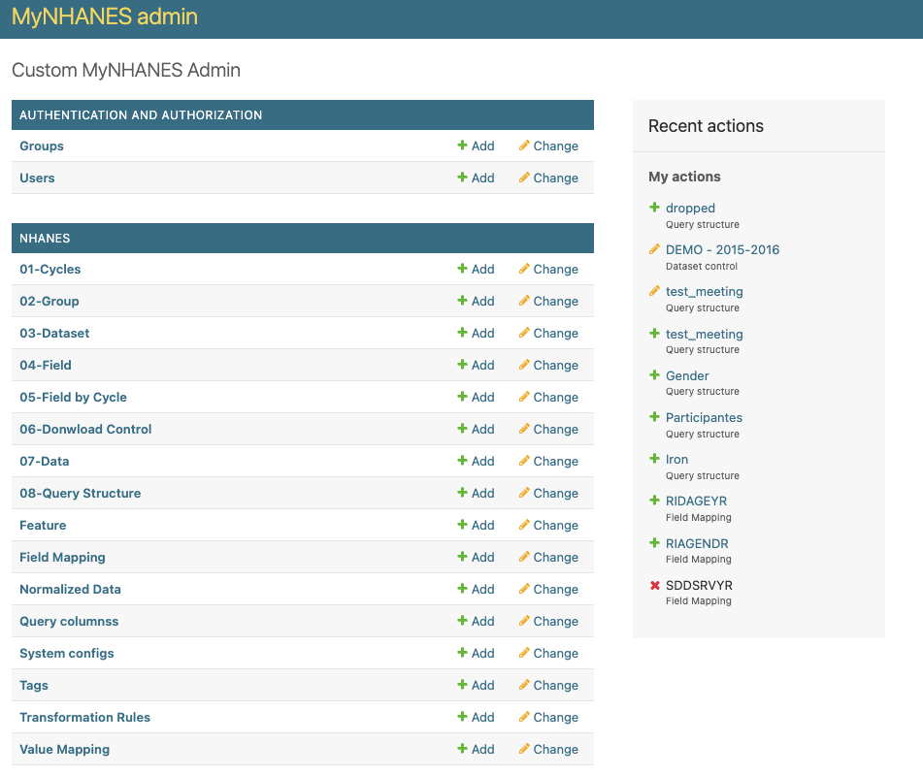
MyNHANES
Simple way to get NHANES data
Python + DB
Install
Setup
Load
Query

Slide 12

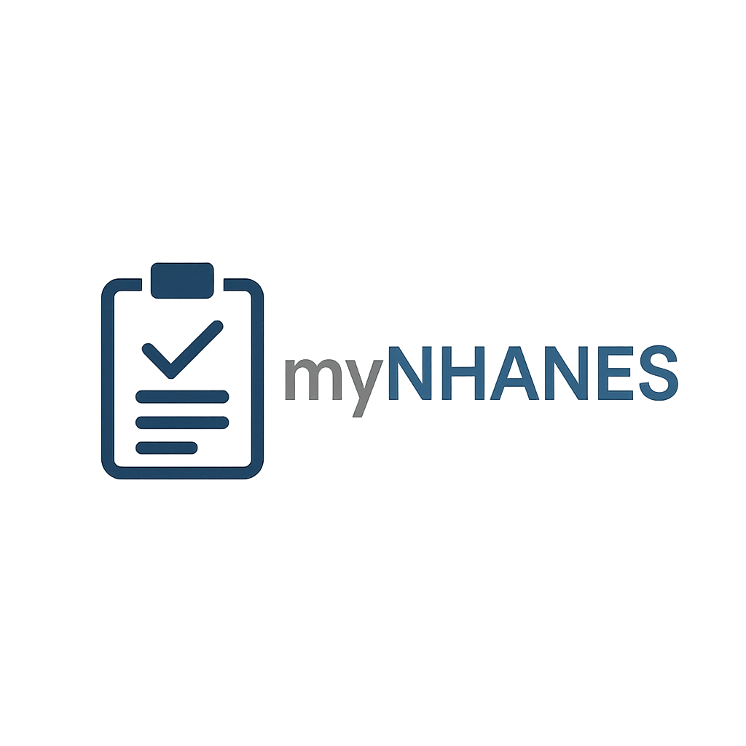



Molly Hall
molly.hall@pennmedicine.upenn.edu
Andre Rico
ricoa@pennmedicine.upenn.edu

